Slide 1
Chromameter measurements for determination of carapace conditions
Measurement was done as an average of three consecutive measurements with a Konica-MinoltaCR-400 chroma meter (with CIELAB color space, L*a*b*) on 5 different parts of the body (one on the dorsal side and 4 on the ventral side of the body) as follows:
1: Intestinal region of the carapace
2: 3rd segment of the abdomen
3: Tracic sternite
4: middle of the merus of the 2nd pereopod
5: lower ventral side of the cheliped
Notes:
The chromameter is a tool for precise and objective assessment of surface color

Slide 2
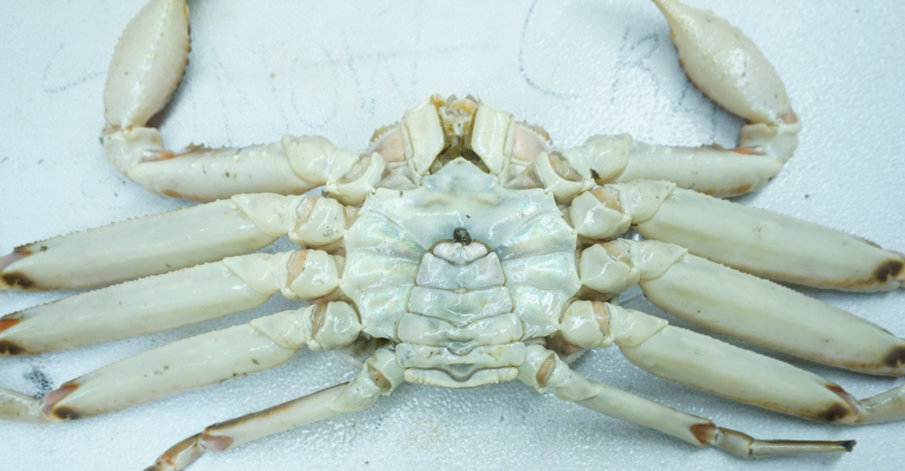
Determination of carapace conditions

Slide 3
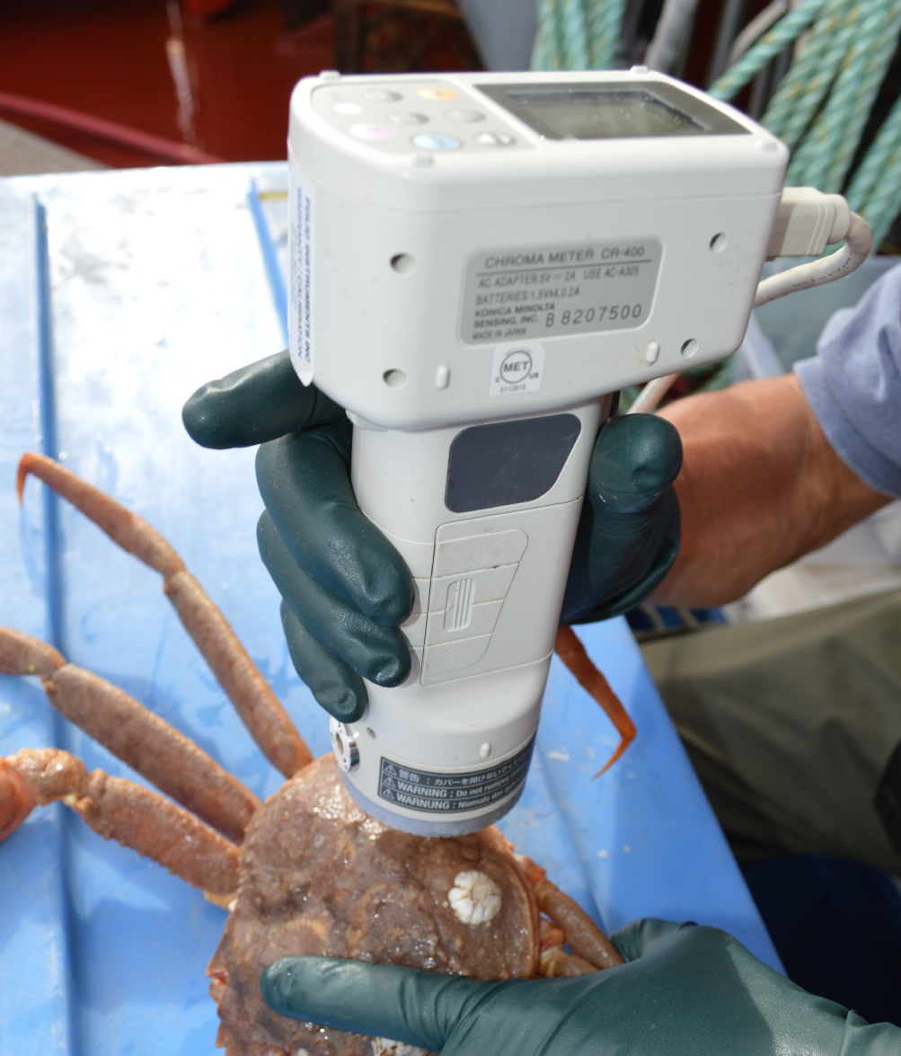
Konica-MinoltaCR-400 Chroma Meter
Quantification of color in order to replace highly subjective method for the determination of carapace conditions.
L*a*b* color space (CIELAB) is used (L*: lightness, a* and b*: Chromaticity coodinates, a* + red, - green; b* + yellow, - blue).
Establish numerical criteria for each carapace condition (Clean CC1-2, medium CC3,3M, dirty CC 4, very dirty CC5).

Slide 4
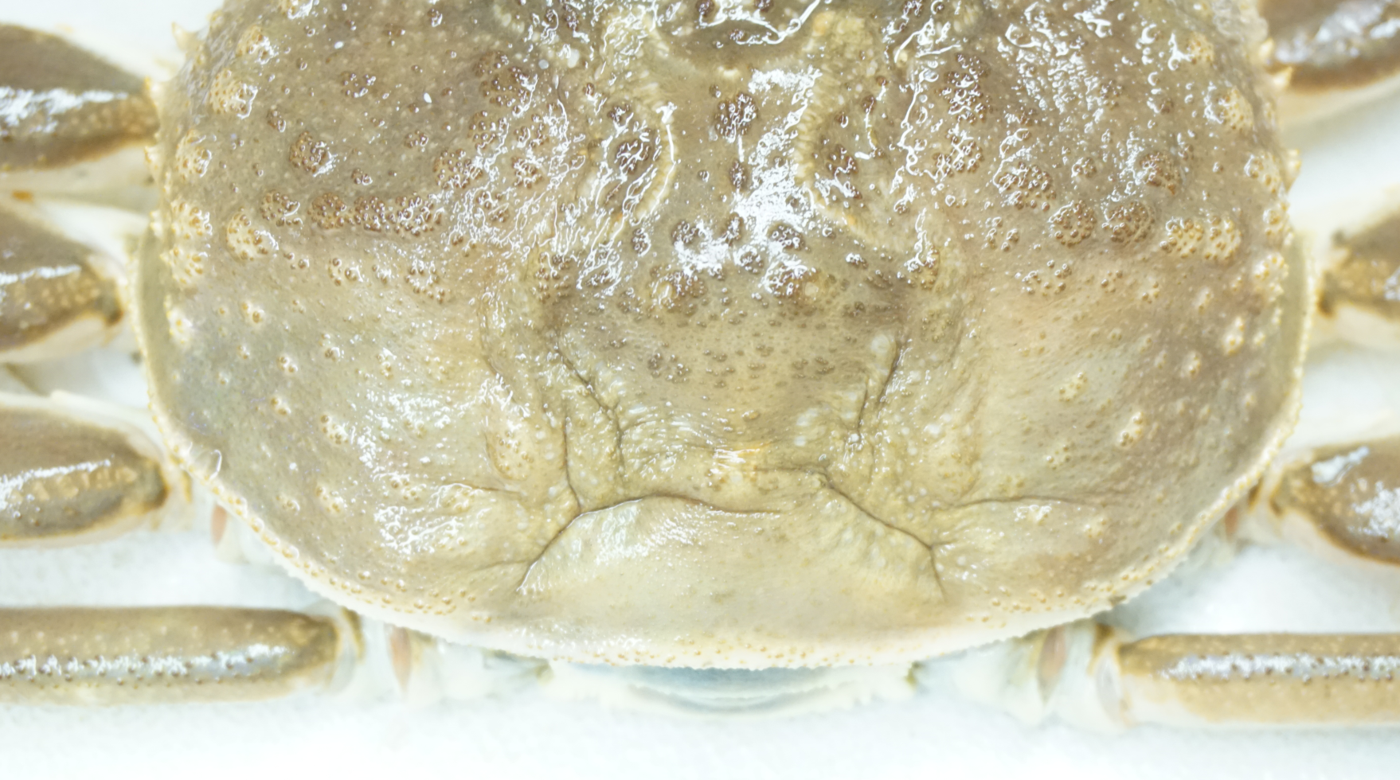
1: Intestinal region of the carapace

Slide 5
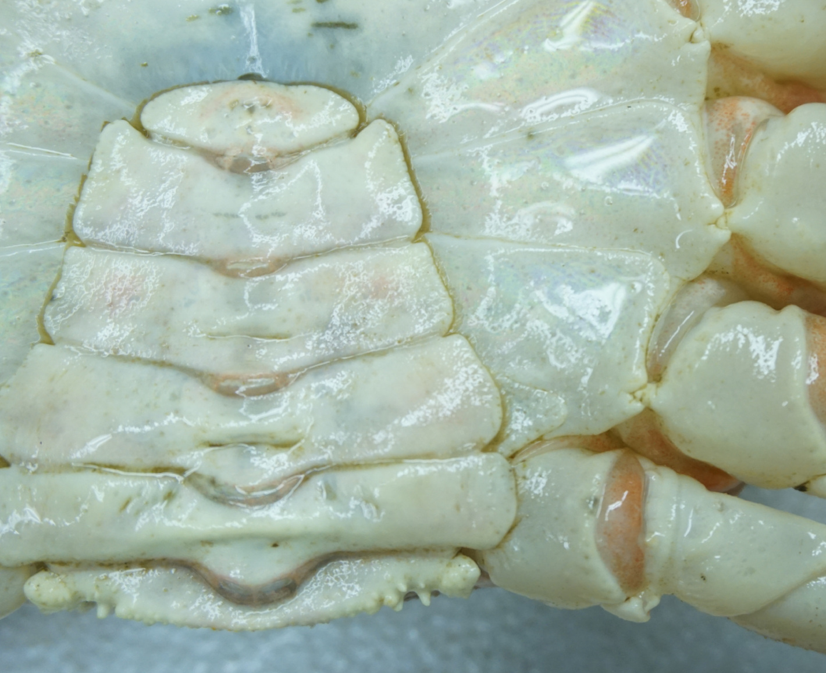

2: 3rd segment of the abdomen

Slide 6

3: Tracic sternite

Slide 7
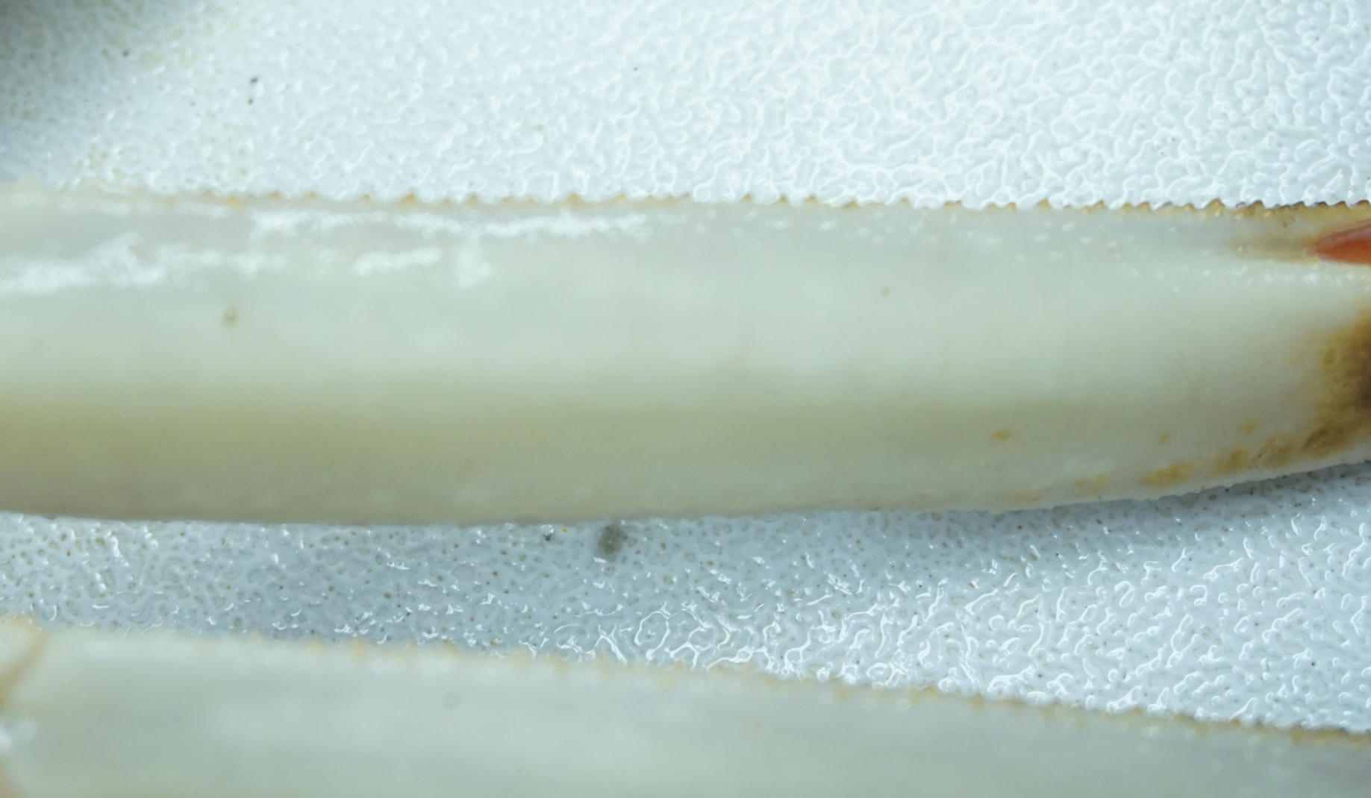
4: Merus of the 2nd pereopod (lower ventral side)

Slide 8
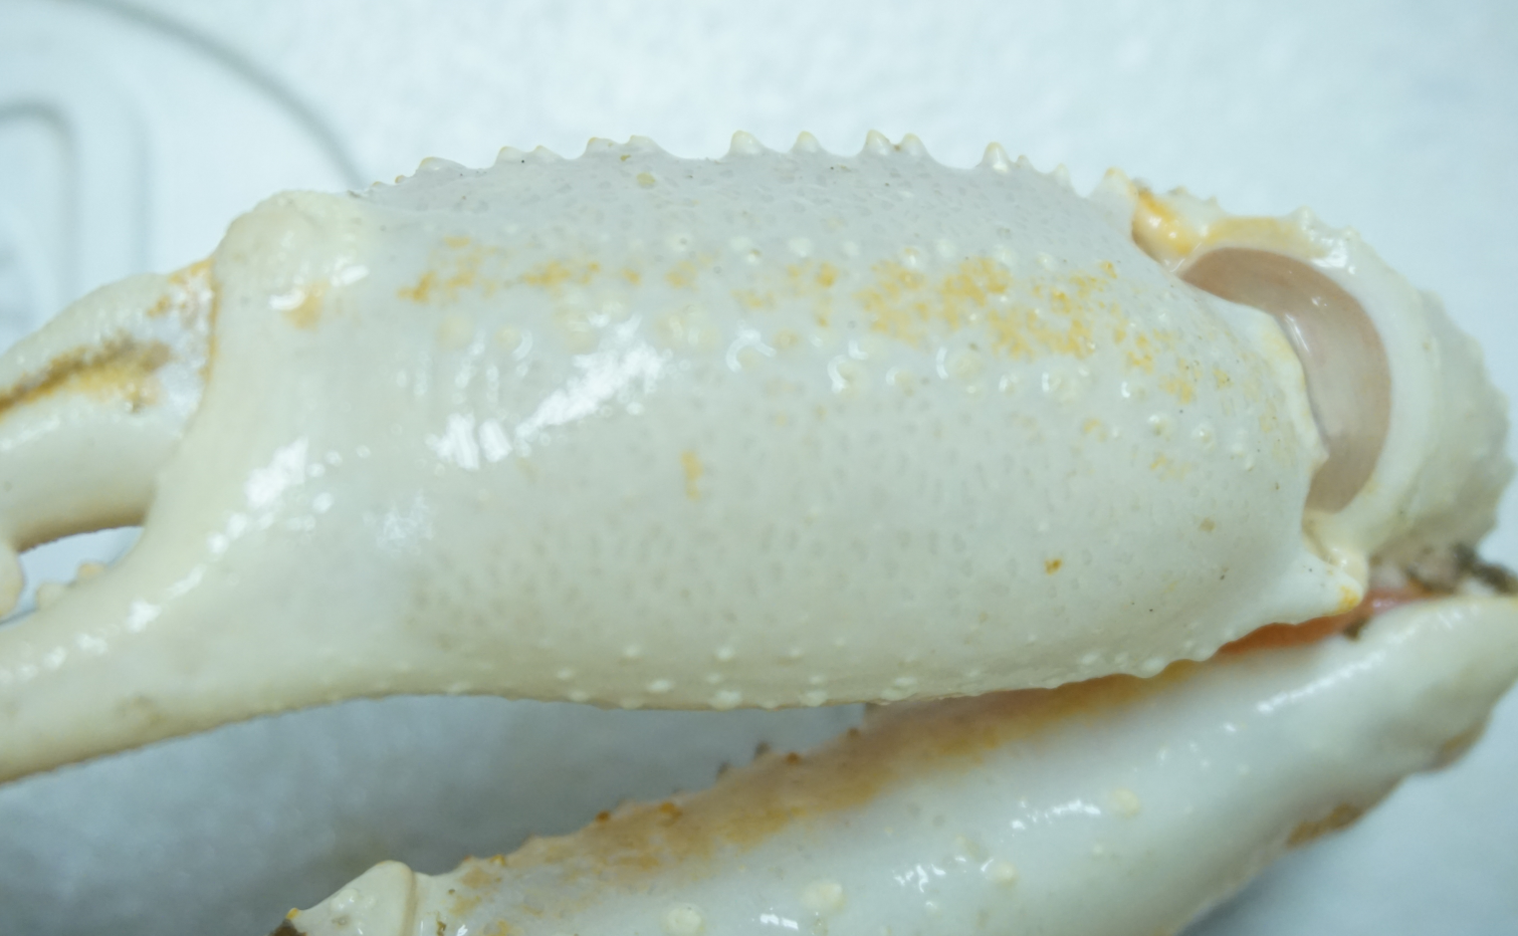
5: Cheliped (lower ventral side) of the

Slide 9
Objective
To replace subjective naked eye determination of snow crab carapace conditions based on the degree of epibiont caverage by a numerical (objective) color measurement with a chromameter;
Chose a best position for carapace condition measurement with a chromameter;

Slide 10
Notes
The study started in September 2015 during tagging project on CSS Perley. Approximately two hundred fifty (250) adult males were measured.
The preliminary analysis will be conducted in 2015 and sampling resumes in 2016 (during the 2016 tagging project and trawl survey);
Preliminary results will be presented at RAP in January 2017;
Need more samples, but color sampling takes 1.5 minutes/individual onboard;
Need blue tooth chromameter when this method is deemed to be efficient/usable;

